Slide 1
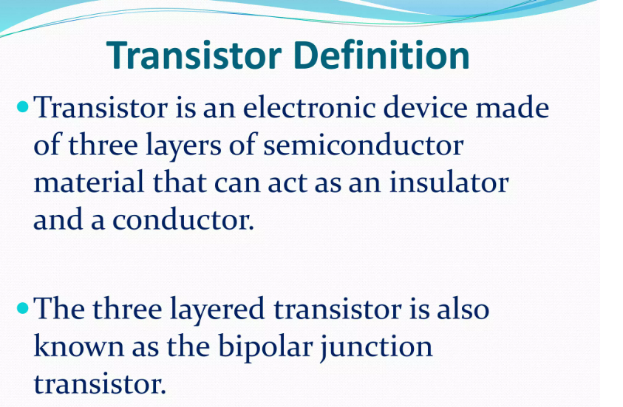

Slide 2


Slide 3
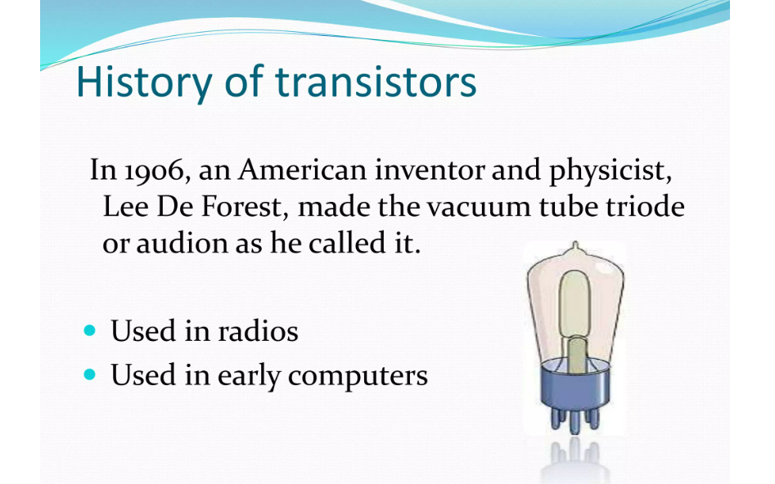

Slide 4
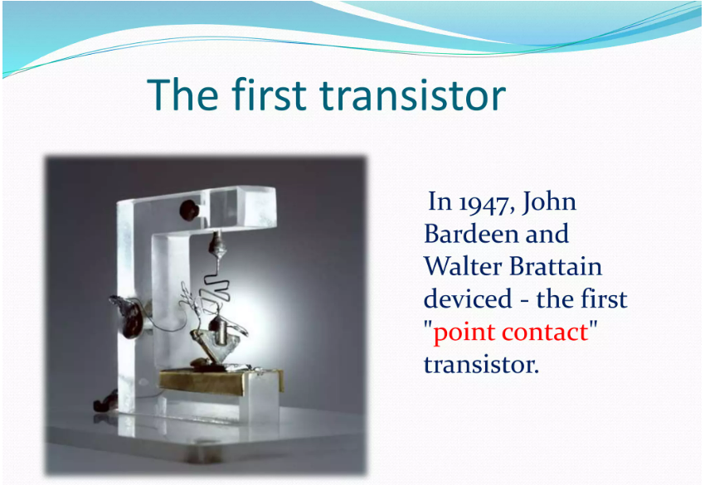

Slide 5
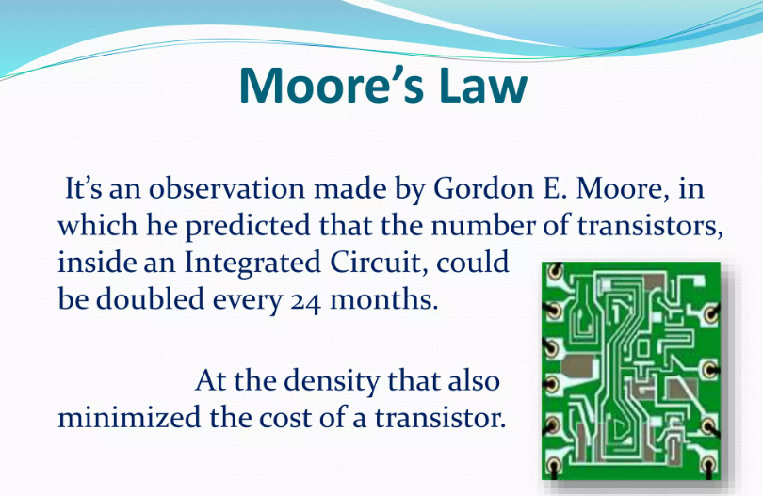

Slide 6
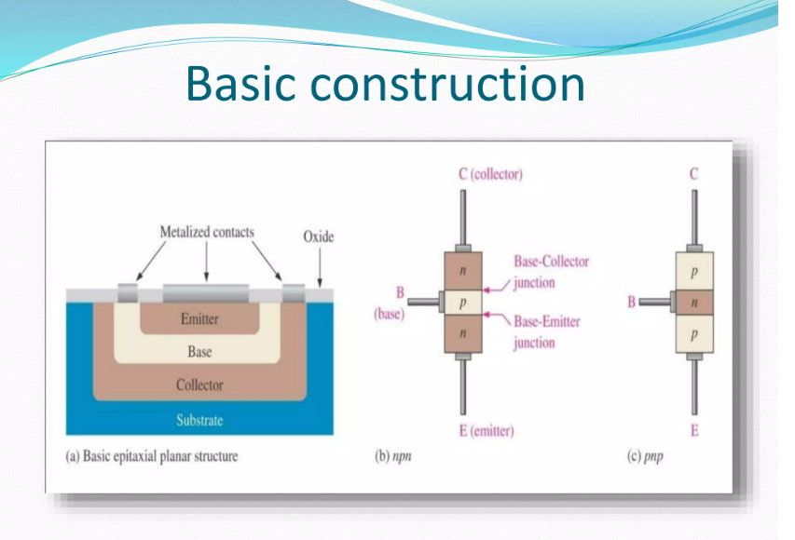

Slide 7
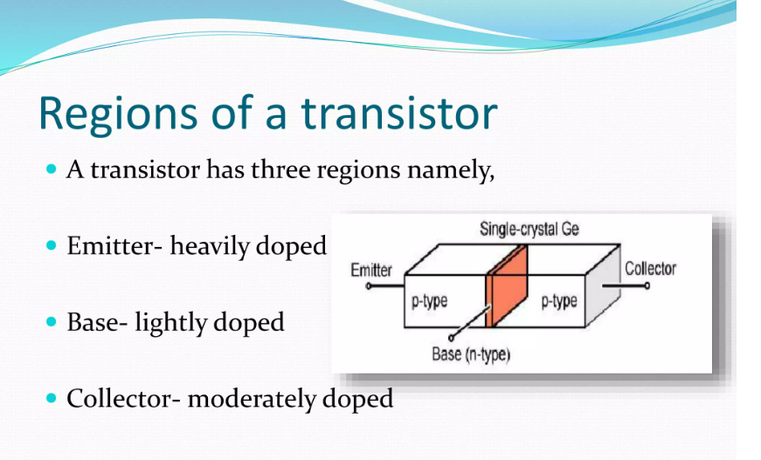

Slide 8
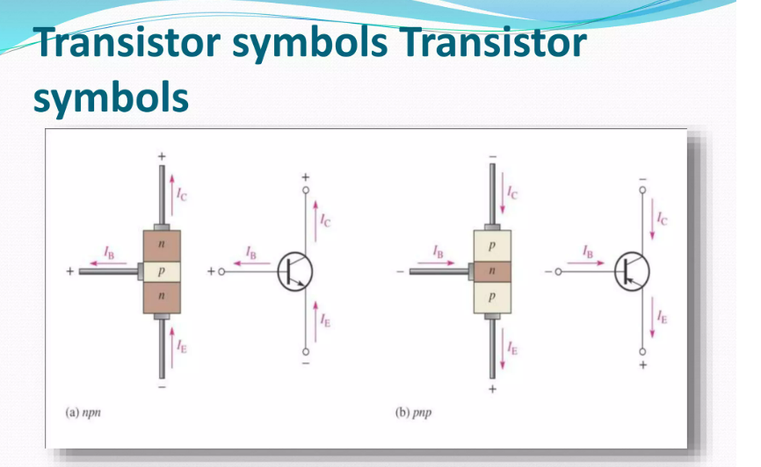

Slide 9
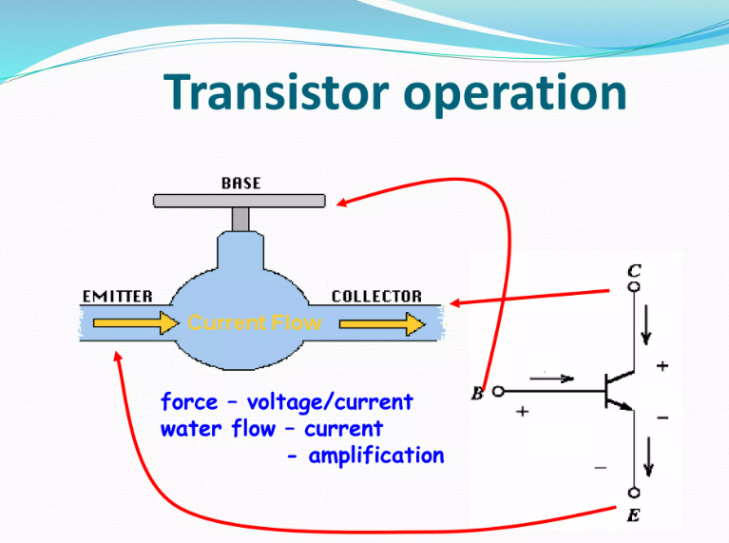

Slide 10
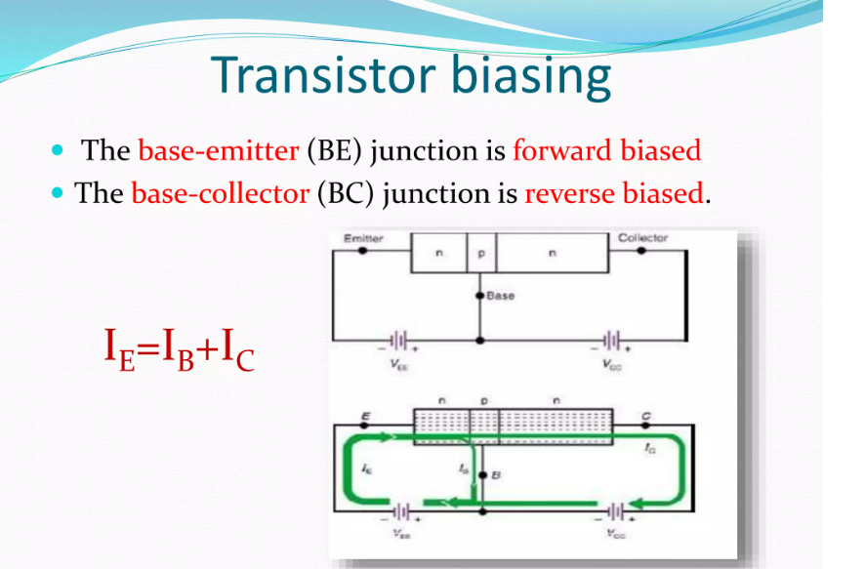

Slide 11
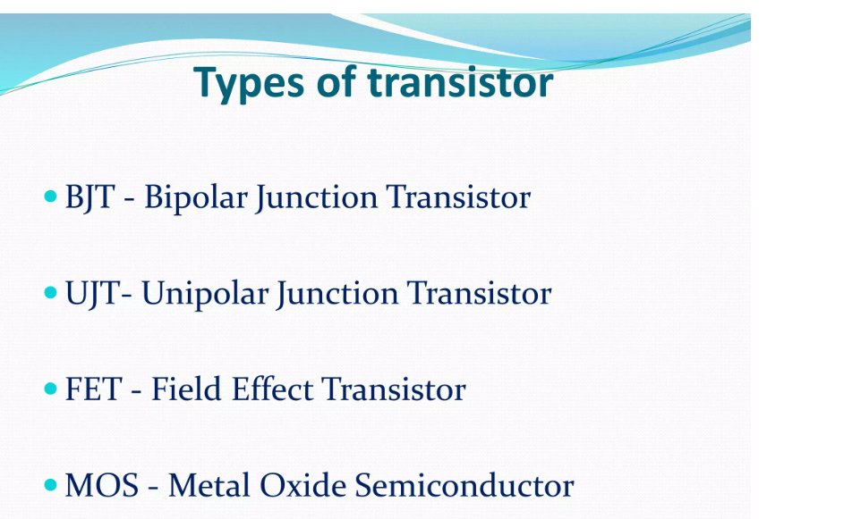

Slide 12
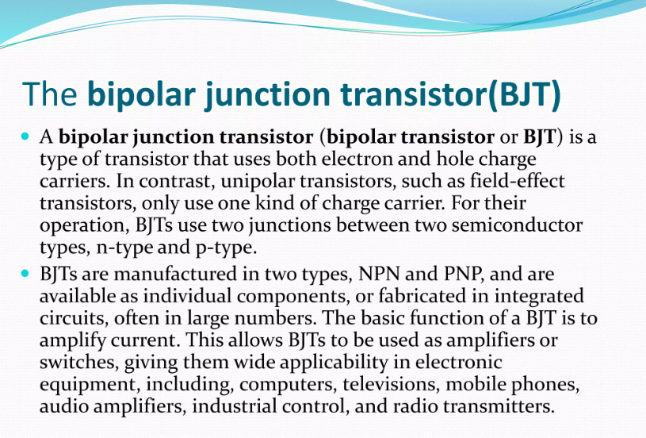

Slide 13
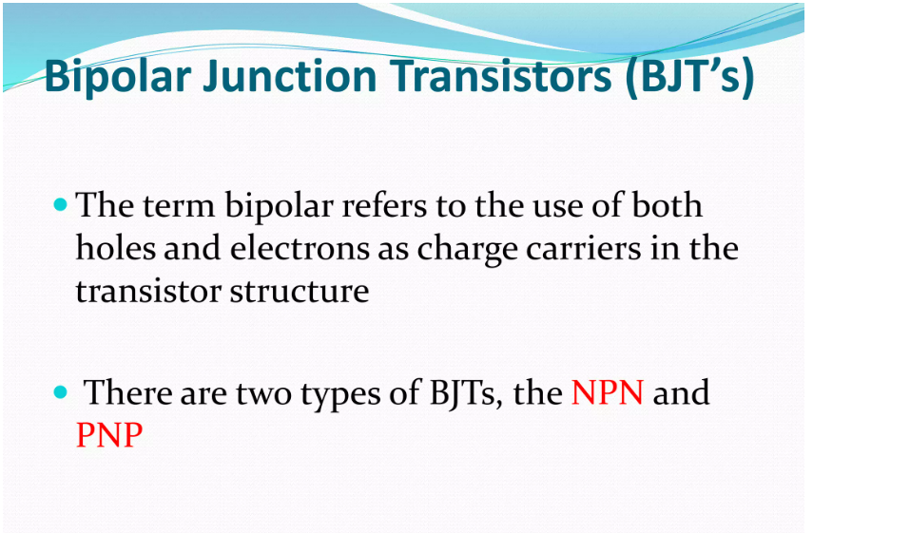

Slide 14
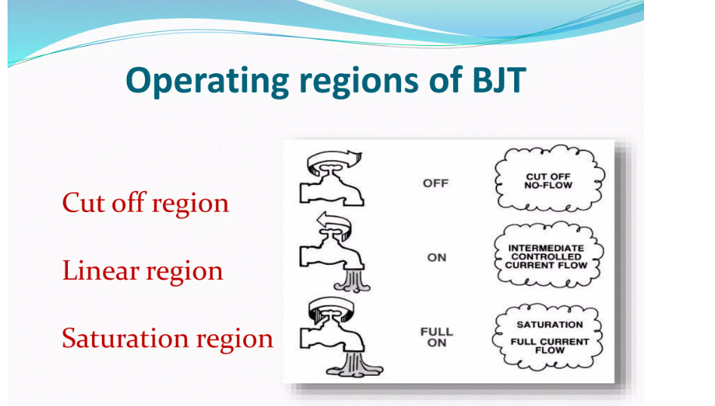

Slide 15
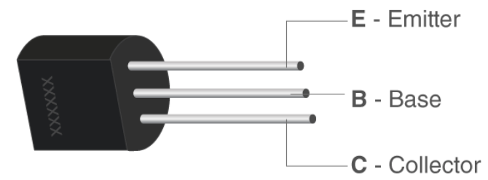
Parts of a Transistor
A typical transistor is composed of three layers of semiconductor materials or, more specifically, terminals which help to make a connection to an external circuit and carry the current. A voltage or current that is applied to any one pair of the terminals of a transistor controls the current through the other pair of terminals. There are three terminals for a transistor. They are listed below:
Base: This is used to activate the transistor.
Collector: It is the positive lead of the transistor.
Emitter: It is the negative lead of the transistor.

Slide 16
Types of Transistors
There are mainly two types of transistors, based on how they are used in a circuit.
Bipolar Junction Transistor (BJT)
The three terminals of BJT are the base, emitter and collector. A very small current flowing between the base and emitter can control a larger flow of current between the collector and emitter terminal.
Furthermore, there are two types of BJT, and they include:
P-N-P Transistor: It is a type of BJT where one n-type material is introduced or placed between two p-type materials. In such a configuration, the device will control the flow of current. PNP transistor consists of 2 crystal diodes which are connected in series. The right side and left side of the diodes are known as the collector-base diode and emitter-base diode, respectively.
N-P-N Transistor: In this transistor, we will find one p-type material that is present between two n-type materials. N-P-N transistor is basically used to amplify weak signals to strong signals. In an NPN transistor, the electrons move from the emitter to the collector region, resulting in the formation of current in the transistor. This transistor is widely used in the circuit.

Slide 17
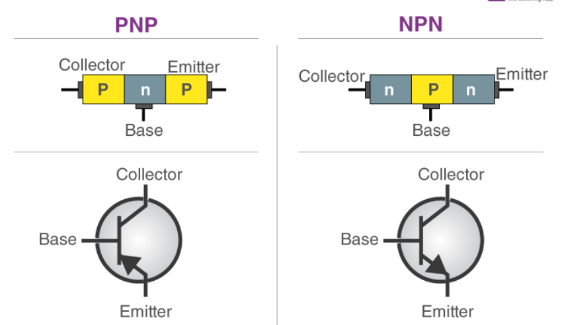

Slide 18
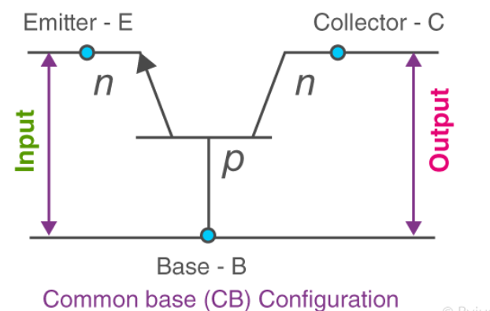
There are three types of configuration, which are common base (CB), common collector (CC) and common emitter (CE).
In common base (CB) configuration, the base terminal of the transistor is common between input and output terminals.

Slide 19
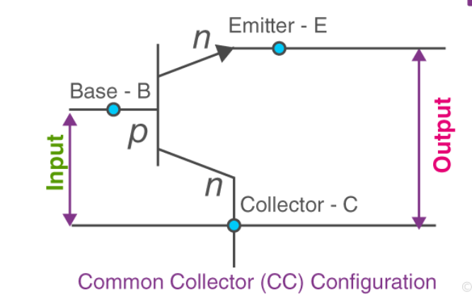
In common collector (CC) configuration, the collector terminals are common between the input and output terminals.

Slide 20
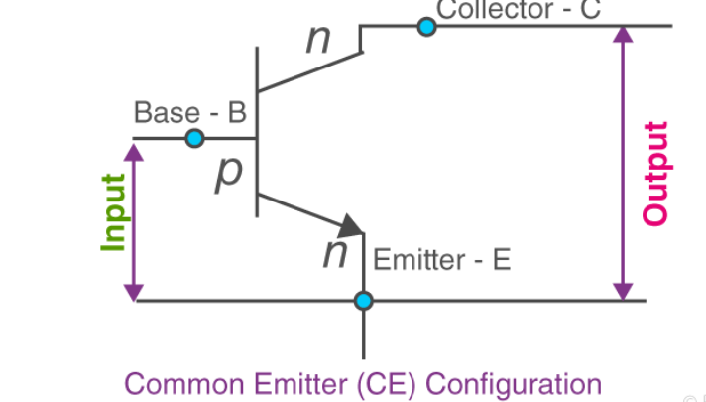
In common emitter (CE) configuration, the emitter terminal is common between the input and the output terminals.

Slide 21
How Do Transistors Work?
Let us look at the working of transistors. We know that BJT consists of three terminals (Emitter, Base and Collector). It is a current-driven device where two P-N junctions exist within a BJT.
One P-N junction exists between the emitter and base region, and the second junction exists between the collector and base region. A very small amount of current flow through the emitter to the base can control a reasonably large amount of current flow through the device from the emitter to the collector.
In the usual operation of BJT, the base-emitter junction is forward-biased, and the base-collector junction is reverse-biased. When a current flows through the base-emitter junction, the current will flow in the collector circuit.
In order to explain the working of the transistor, let us take an example of an NPN transistor. The same principles are used for the PNP transistor, except that the current carriers are holes, and the voltages are reversed.

Slide 22
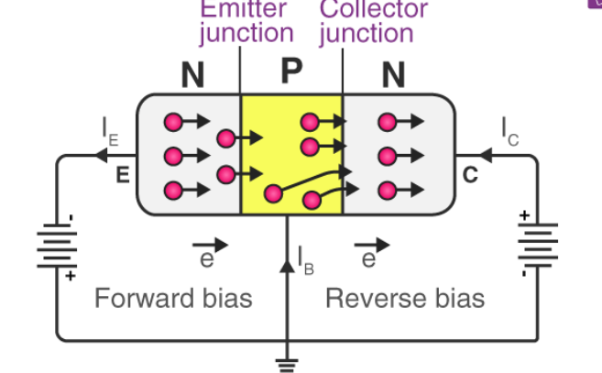
Operation of NPN Transistor
The emitter of the NPN device is made of n-type material; hence, the majority of carriers are electrons. When the base-emitter junction is forward-biased, the electrons will move from the n-type region towards the p-type region, and the minority carrier holes move towards the n-type region.
When they meet each other, they will combine, enabling a current to flow across the junction. When the junction is reverse-biased, the holes and electrons move away from the junction, and now, the depletion region forms between the two areas and no current will flow through it.

Slide 23
When a current flows between the base and emitter, the electrons will leave the emitter and flow into the base, as shown above. Normally, the electrons will combine when they reach the depletion region.
But the doping level in this region is very low, and the base is also very thin. This means that most of the electrons are able to travel across the region without recombining with holes. As a result, the electrons will drift towards the collector.
In this way, they are able to flow across what is effectively a reverse-biased junction, and the current flows in the collector circuit.

Slide 24
Characteristics of Transistor
Characteristics of the transistor are the plots which can represent the relation between the current and the voltage of a transistor in a particular configuration.
There are two types of characteristics.
Input characteristics: It will give us the details about the change in input current with the variation in input voltage by keeping output voltage constant.
Output characteristics: It is a plot of output current with output voltage by keeping the input current constant.
Current transfer characteristics: This plot shows the variation of the output current with the input current by keeping the voltage constant.

